Slide 1

Software Engineering (CS34102)
Software Project Planning
Course Co-ordinator:
Prof. (Dr.) D.S. Kushwaha
Course Instructor: Akanksha Gaur
Department of Computer Science and Engineering
MNNIT, Allahabad

Slide 2
Contents
Software Project Planning
Size Estimation
Growth of Lines of Code
Function Point
Function Point Analysis
Functional Unit
Functional Unit Categories
Special Features
Counting Function Points
Calculation of UFP
Computing Function Points
Number of factors considered ( Fi )
Metrics
Relative Cost of Software Phases
Cost to Detect and Fix Faults

Slide 3
Software Project Planning
After the finalization of SRS, estimate
size
cost
development time
Customer may like to know the cost and development time even prior to finalization of the SRS.
3

Slide 4
Software Project Planning
Scope of work to be done
The risk to be incurred
The resources required
The task to be accomplished
The cost to be expended
The schedule to be followed
4
Notes:
In order to conduct a successful software project, we must understand:

Slide 5
Software Project Planning
Size Estimation
Software planning begins before technical work starts, continues as the software evolves from concept to reality, and culminates only when the software is retired.
Cost Estimation
Development Time
Resource Requirements
Project Scheduling
5
Notes:
Activities during Software Project Planning

Slide 6
Size Estimation
1. | int. sort (int x[ ], int n)
2. | {
3. | int i, j, save, im1;
4. | /*This function sorts array x in ascending order */
5. | If (n<2) return 1;
6. | for (i=2; i<=n; i++)
7. | {
8. | im1=i-1;
9. | for (j=1; j<=im; j++)
10. | if (x[i] < x[j])
11. | {
12. | Save = x[i];
13. | x[i] = x[j];
14. | x[j] = save;
15. | }
16. | }
17. | return 0;
18. | }
Lines of Code (LOC)
If LOC is simply a count of the number of lines then figure shown below contains 18 LOC .
When comments and blank lines are ignored, the program in figure 2 shown below contains 17 LOC.
Function for sorting an array
6

Slide 7

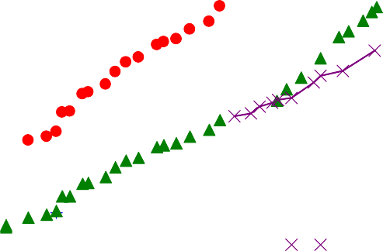
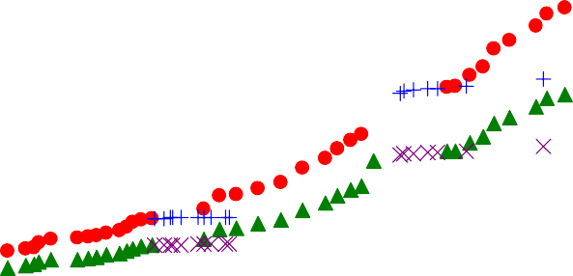
Growth of Lines of Code
2,500,000
Total LOC ("wc -l") -- development releases
Total LOC ("wc -l") -- stable releases
Total LOC uncommented -- development releases Total LOC uncommented -- stable releases
2,000,000
Total LOC
1,500,000
1,000,000
500,000
0
Jan 1993
Jun 1994
Oct 1995
Mar 1997
Jul 1998
Dec 1999
Apr 2001
7

Slide 8
Software Project Planning
If the main interest is the size of the program for specific functionality, it may be reasonable to include executable statements.
Executable statements: lines 5-17 leading to a count of 13.
The differences in the counts are 18 to 17 to 13.
One can easily see the potential for major discrepancies for large programs with many comments or programs written in language that allow a large number of descriptive but non-executable statement.
8

Slide 9
Conte’s definition of lines of code
“A line of code is any line of program text that is not a comment or blank line, regardless of the number of statements or fragments of statements on the line. This specifically includes all lines containing program header, declaration, and executable and non-executable statements”.
This is the predominant definition for lines of code used by researchers. By this definition, figure shown earlier has 17 LOC.
9

Slide 10
Function Count
Alan Albrecht while working for IBM, recognized the problem in size measurement in the 1970s, and developed a technique (which he called Function Point Analysis), which appeared to be a solution to the size measurement problem.
10

Slide 11
Albrecht’s Function Point Analysis
The principle of Albrecht’s function point analysis (FPA) is that a system is decomposed into functional units.
Inputs: information entering the system
Outputs: information leaving the system
Enquiries: requests for instant access to information
Internal logical files: information held within the system
External interface files: information held by other system that is used by the system being analyzed.
11

Slide 12
FPA Functional Units
User
Inquiries
ILF
System
Input
EIF
Application
User
Output
User
ILF: Internal logical files EIF: External interfaces
FPAs functional units System
12

Slide 13
Categories of Functional Units
The five functional units are divided in two categories:
(i) Data function types
Internal Logical Files (ILF): A user identifiable group of logical related data or control information maintained within the system.
External Interface files (EIF): A user identifiable group of logically related data or control information referenced by the system, but maintained within another system. This means that EIF counted for one system, may be an ILF in another system.
13

Slide 14
Categories of Functional Units
Transactional function types
External Input (EI): An EI processes data or control information that comes from outside the system. The EI is an elementary process, which is the smallest unit of activity that is meaningful to the end user in the business.
External Output (EO): An EO is an elementary process that generate data or control information to be sent outside the system.
External Inquiry (EQ): An EQ is an elementary process that is made up to an input-output combination that results in data retrieval.
14

Slide 15
Special Features
Function point approach is independent of the language, tools, or methodologies used for implementation; i.e. they do not take into consideration programming languages, data base management systems, processing hardware or any other data base technology.
Function points can be estimated from requirement specification or design specification, thus making it possible to estimate development efforts in early phases of development.
15

Slide 16
Special Features
Function points are directly linked to the statement of requirements; any change of requirements can easily be followed by a re-estimate.
Function points are based on the system user’s external view of the system, non-technical users of the software system have a better understanding of what function points are measuring.
16

Slide 17
Counting Function Points
Functional Units | Weighting factors
 | Low | Average | High
External Inputs (EI) | 3 | 4 | 6
External Output (EO) | 4 | 5 | 7
External Inquiries (EQ) | 3 | 4 | 6
External logical files (ILF) | 7 | 10 | 15
External Interface files (EIF) | 5 | 7 | 10
Functional units with weighting factors
17

Slide 18
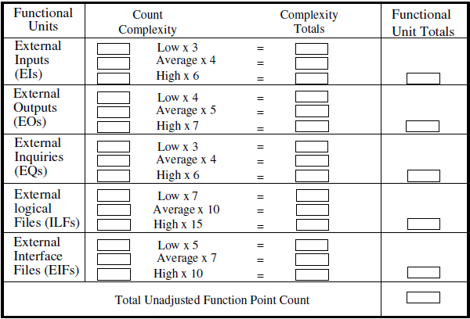
The weighting factors are identified for all functional units and multiplied with the functional units accordingly.
The procedure for the calculation of Unadjusted Function Point (UFP) is given in table shown above.
UFP Calculation Table
18

Slide 19
Calculation of UFP
5 3
UFP = ∑∑ Z_{ij} w_{ij}
i=1 J =1
Where i indicate the row and j indicates the column of Table 1
W_{ij} : It is the entry of the i^{th} row and j^{th} column of the table 1
Zij : It is the count of the number of functional units of Type i that have been classified as having the complexity corresponding to column j.
19

Slide 20
Calculation of UFP
Organizations that use function point methods develop a criterion for determining whether a particular entry is Low, Average or High. Nonetheless, the determination of complexity is somewhat subjective.
FP = UFP * CAF
Where CAF is complexity adjustment factor and is equal to [0.65 + 0.01 x ΣF_{i}].
F_{i} (i=1 to 14) is the degree of influence and are based on responses to questions noted in table 3.
20

Slide 21
Computing Function Points
Rate each factor on a scale of 0 to 5.
0 1 2 3 4 5
No Influence
Essential
Incidental Moderate Significant
Average
21

Slide 22
Number of factors considered ( F_{i} )
Does the system require reliable backup and recovery ?
Is data communication required ?
Are there distributed processing functions ?
Is performance critical ?
Will the system run in an existing heavily utilized operational environment ?
Does the system require on line data entry ?
Does the on line data entry require the input transaction to be built over multiple screens or operations ?
Are the master files updated on line ?
Is the inputs, outputs, files, or inquiries complex ?
Is the internal processing complex ?
Is the code designed to be reusable ?
Are conversion and installation included in the design ?
Is the system designed for multiple installations in different organizations ?
Is the application designed to facilitate change and ease of use by the user ?
22

Slide 23
Metrics
Productivity Quality | = = | FP / persons-months Defects / FP
Cost | = | Rupees / FP
Documentation | = | Pages of documentation per FP
These metrics are controversial and are not universally acceptable. There are standards issued by the International Functions Point User Group (IFPUG, covering the Albrecht method) and the United Kingdom Function Point User Group (UFPGU, covering the MK11 method). An ISO standard for function point method is also being developed.
23

Slide 24
Example
Consider a project with the following functional units:
Number of user inputs
Number of user outputs
Number of user enquiries
Number of user files
Number of external interfaces= 04
= 50
= 40
= 35
= 06
Assume all complexity adjustment factors and weighting factors are average. Compute the function points for the project.
24

Slide 25
Solution
We know
5 3
UFP = ∑∑ Z_{ij} w_{ij}
i=1 J =1
UFP = 50 x 4 + 40 x 5 + 35 x 4 + 6 x 10 + 4 x 7
= 200 + 200 + 140 + 60 + 28 = 628
CAF = (0.65 + 0.01 ΣF_{i})
= (0.65 + 0.01 (14 x 3)) = 0.65 + 0.42 = 1.07 FP = UFP x CAF
= 628 x 1.07 = 672
25

Slide 26
Example
An application has the following:
10 Low external inputs, 12 high external outputs, 20 low internal logical files, 15 high external interface files, 12 average external inquiries, and a value of complexity adjustment factor of 1.10.
What are the unadjusted and adjusted function point counts ?
26

Slide 27
Solution
Unadjusted function point counts may be calculated using as:
5 3
UFP = ∑∑ Z_{ij} w_{ij}
i=1 J =1
= 10 x 3 + 12 x 7 + 20 x 7 + 15 + 10 + 12 x 4
= 30 + 84 +140 + 150 + 48
= 452
FP = UFP x CAF
= 452 x 1.10 = 497.2.
27

Slide 28
Example
Consider a project with the following parameters.
External Inputs:
10 with low complexity (b)15 with average complexity
(c) 17 with high complexity
External Outputs:
6 with low complexity (b)13 with high complexity
External Inquiries:
3 with low complexity
4 with average complexity
2 high complexity
28

Slide 29
Internal logical files:
2 with average complexity
1 with high complexity
External Interface files:
9 with low complexity
In addition to above, system requires
Significant data communication
Performance is very critical
Designed code may be moderately reusable
System is not designed for multiple installation in different organizations.
Other complexity adjustment factors are treated as average. Compute the function points for the project.
29

Slide 30
Functional Units | _{Count Complexity} Complexity Totals |  |  |  |  | Functional Unit Totals
External Inputs | 10 15 | Low x 3 Average x 4 | = = | 30 60
(EIs) | 17 | High x 6 | = | 102 | 192
External Outputs (EOs) | 6 0 13 | Low x 4 Average x 5 High x 7 | = = = | 24 0 91 | 115
External Inquiries (EQs) | 3 4 2 | Low x 3 Average x 4 High x 6 | = = = | 9 16 12 | 37
External logical | 0 2 | Low x 7 Average x 10 | = = | 0 20
Files (ILFs) | 1 High x 15 = |  |  | 15 | 35
External Interface Files (EIFs) | 9 0 0 | Low x 5 Average x 7 High x 10 | = = = | 45 0 0 | 45
 | Total Unadjusted Function Point Count |  |  |  | 424
Solution: Unadjusted function points may be counted

Slide 31
14
∑ ^{F}i = 3+4+3+5+3+3+3+3+3+3+2+3+0+3=41
i=1
CAF = (0.65 + 0.01 x ΣF_{i})
= (0.65 + 0.01 x 41)
= 1.06
FP = UFP x CAF
= 424 x 1.06
= 449.44
Hence FP = 449
31

Slide 32
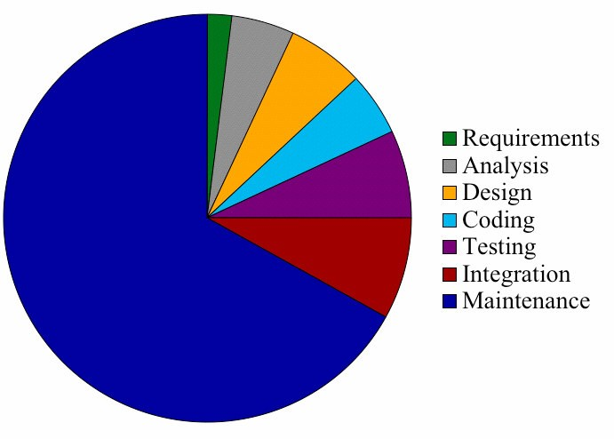
Relative Cost of Software Phases
32

Slide 33
Cost to Detect and Fix Faults
Relative Cost to detect and correct fault
200
180
160
140
120
100
80
60
40
20
0
Cost
Req
Des
Int
33

Slide 34
References
Software Engineering – A Practitioner’s Approach, by Pressman R.S. and Ince D
Software Engineering by Sommerville
Software Engineering Volume 1 and Volume 2 by Thayer and Christiansen
Software Engineering by KK Aggarwal and Yogesh Singh

